Slide 1

Flaunt Github Handy Helper
neeravporiya02/Flaunt_For_Git: Flaunt Website for GIt (github.com)

Slide 2
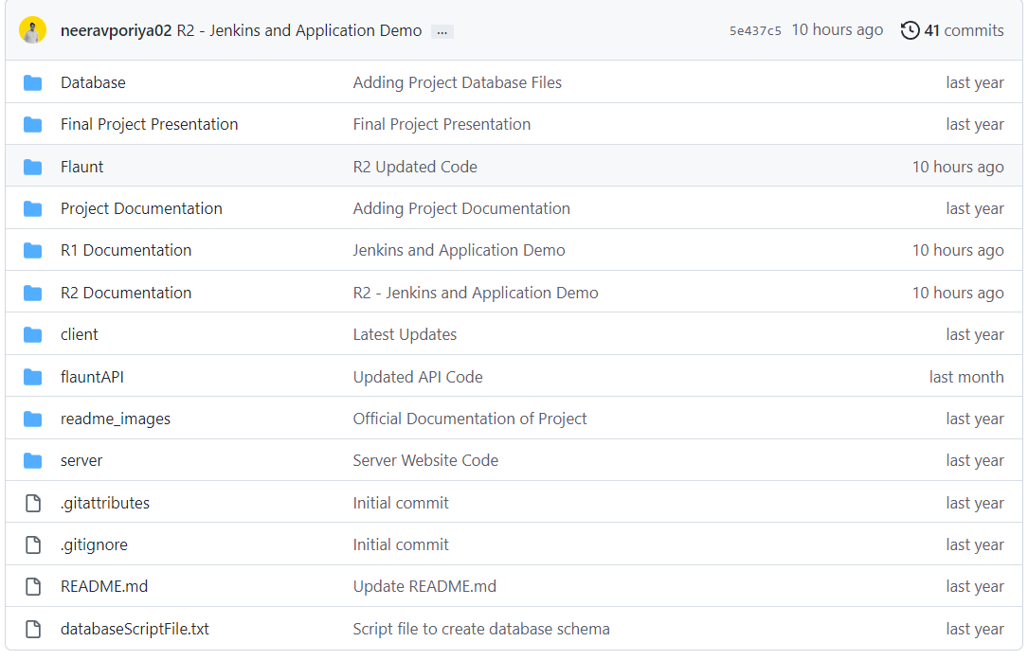
Folder structure for Flaunt Github.

Slide 3
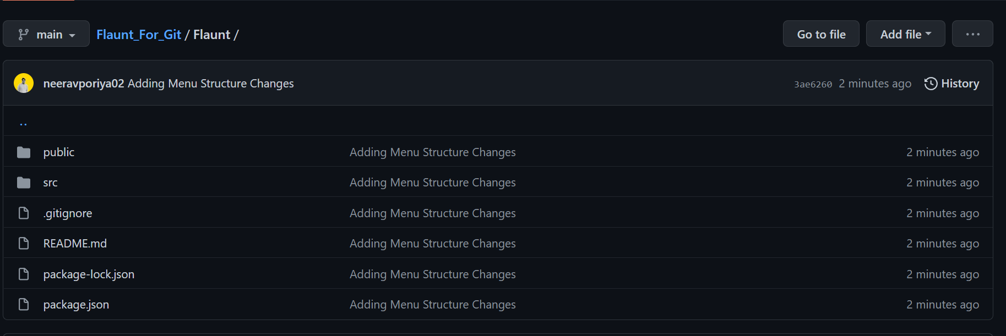
Flaunt Website Structure

Slide 4
FRONT END CODE

Slide 5
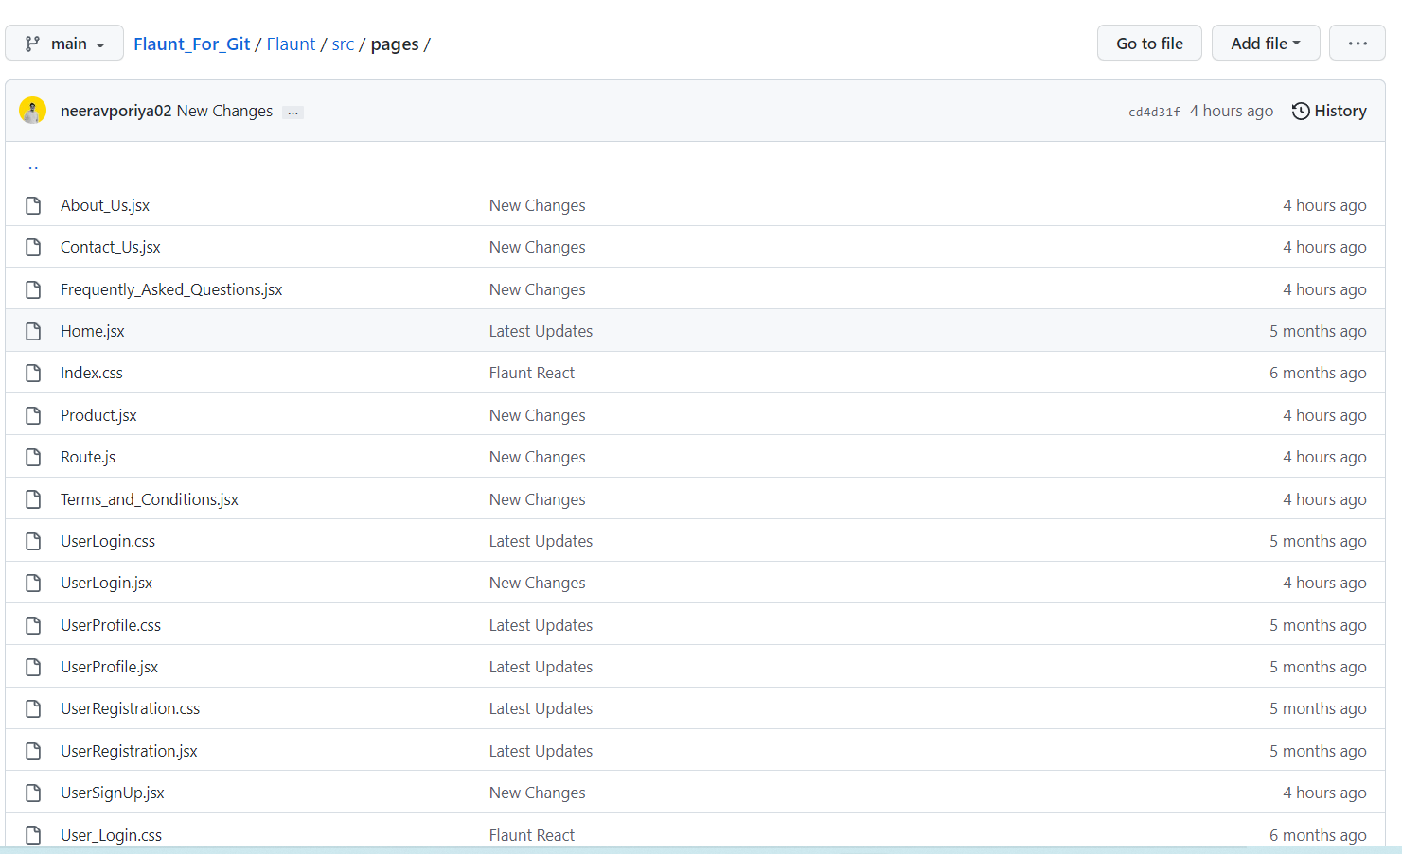
New code pages replacing the html pages.

Slide 6

Page code for Payment Definition page
.

Slide 7
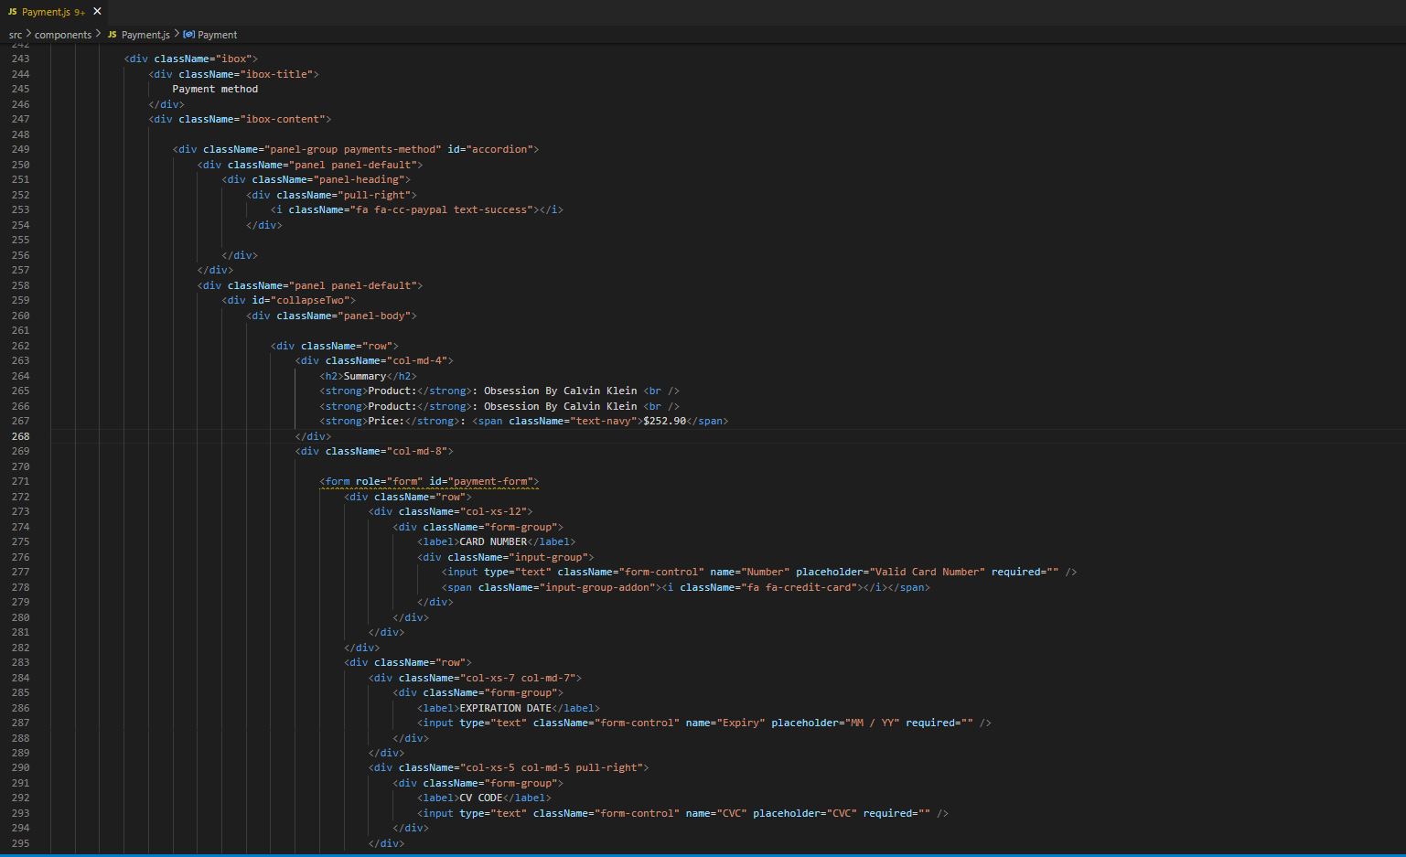
Page code for Product page > Fragrance
.

Slide 8
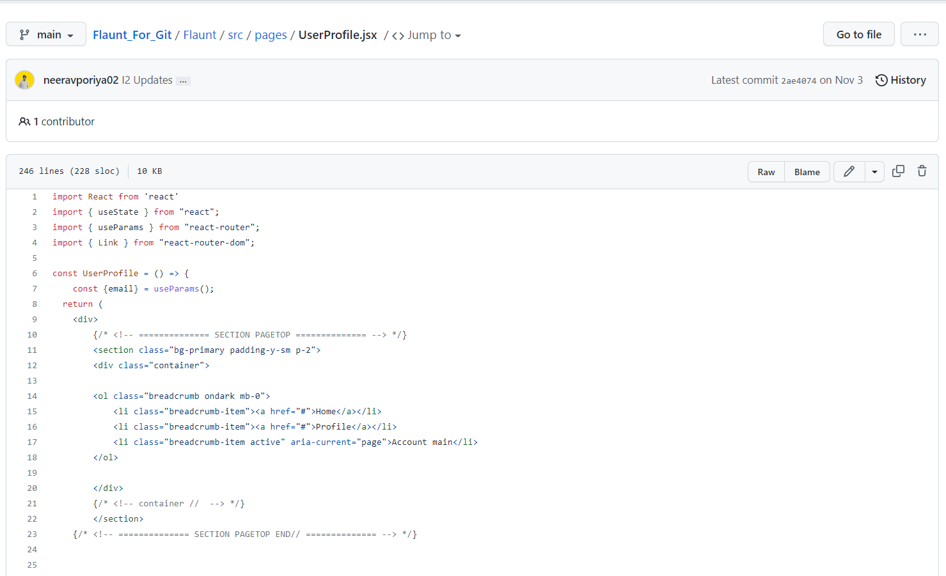
Page code for Product page > User Profile Page
.

Slide 9
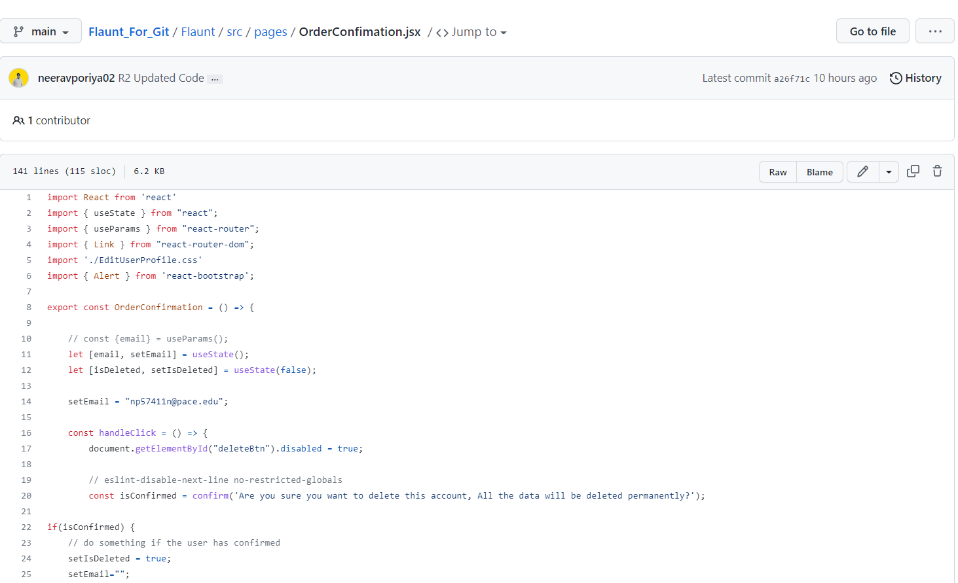
Page code for Product page > Order Confirmation
.

Slide 10
BACKEND CODE

Slide 11
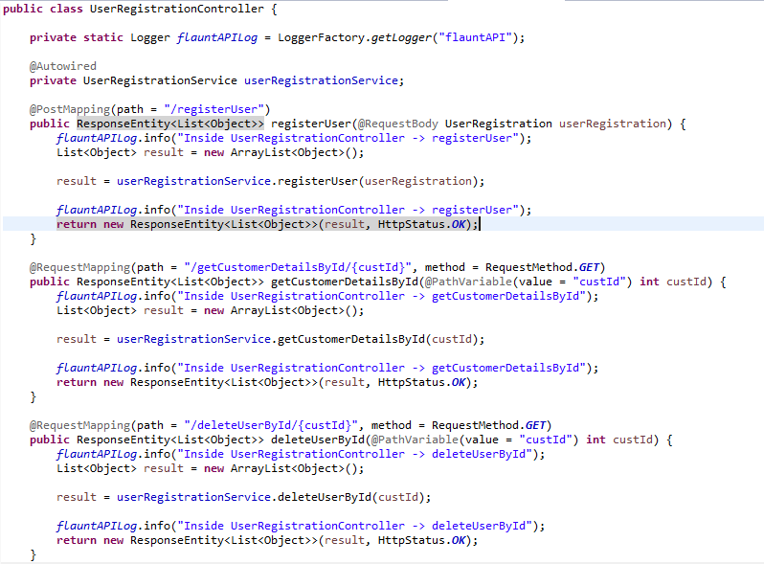
New code page to fetch customer details and deleting user account.

Slide 12
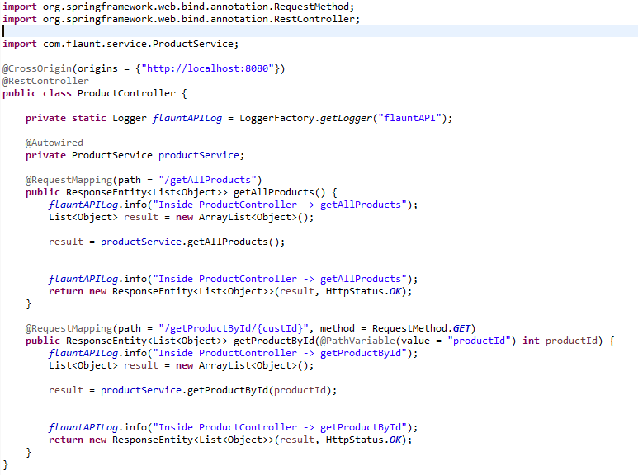
New code page to fetch all products or specific product details.

Slide 13
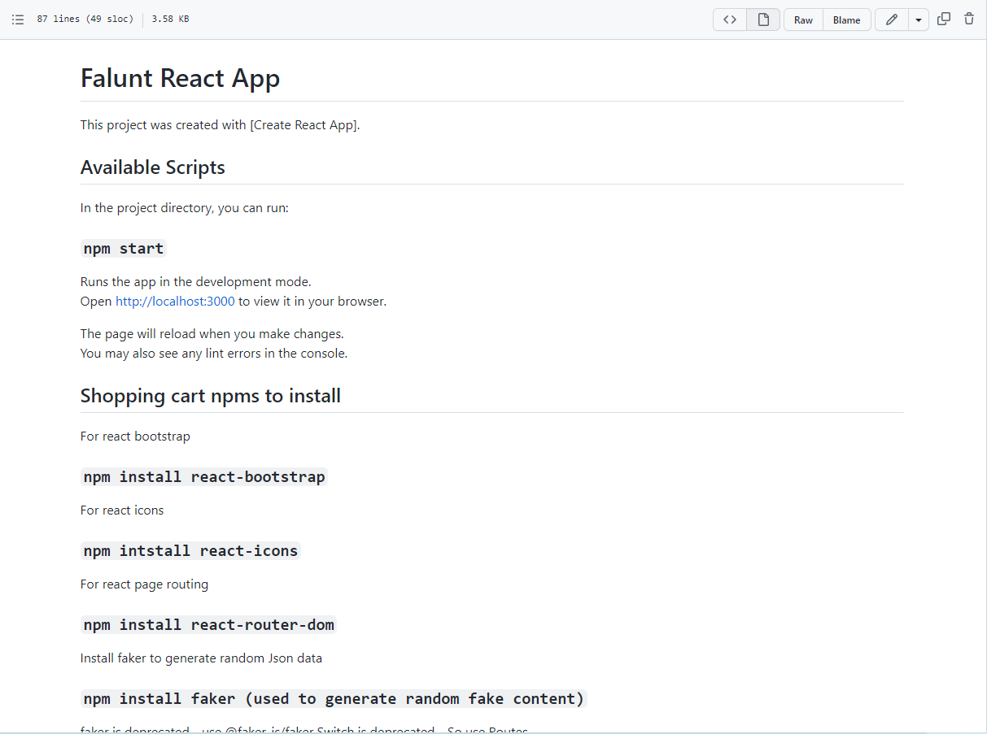
Project Installation and running guide

